Slide 1
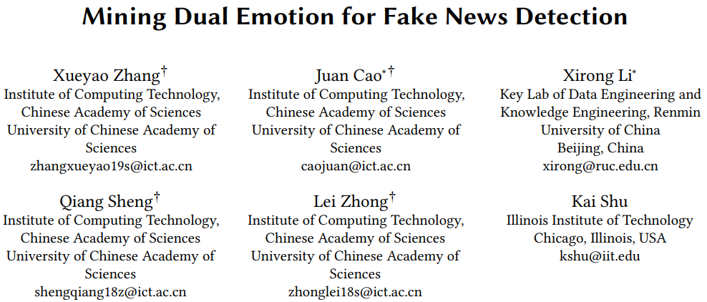
Chongqing University of Technology
ATAI
Advanced Technique of Artificial Intelligence
Chongqing University of Technology
Code:https://github.com/RMSnow/WWW2021
——WWW2021
Reported by ChangJiang Hu

Slide 2
Introduction
Why emotion?
Quantitative analysis:
1.There are distinct distributions of emotional category,emotional intensity and emotional expression between fake and real news.
2.Fake and real news inspire readers’ different emotion categories.

Slide 3
Introduction
Definition
1.Publisher emotion: the emotions conveyed by publishers of news pieces
2.Social emotion: the emotions aroused in the crowd facing to the news pieces
3.Dual emotion: a general term of these two emotions

Slide 4
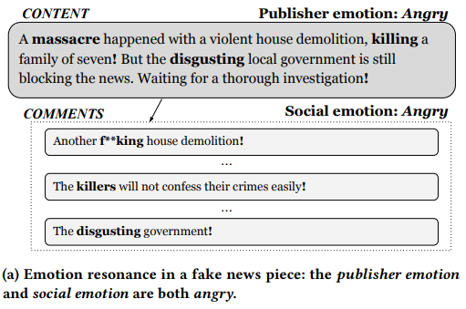
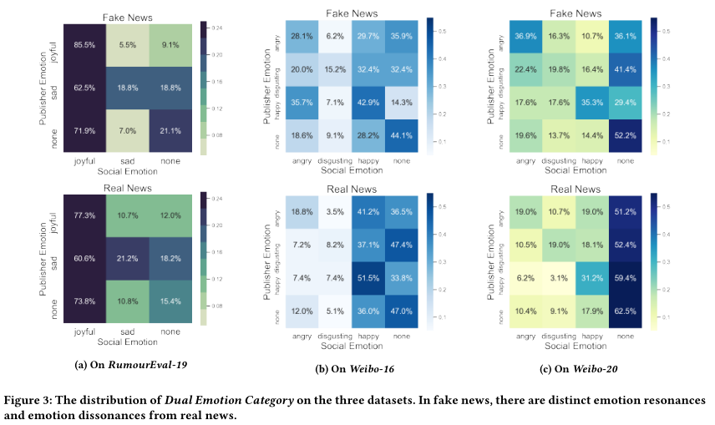
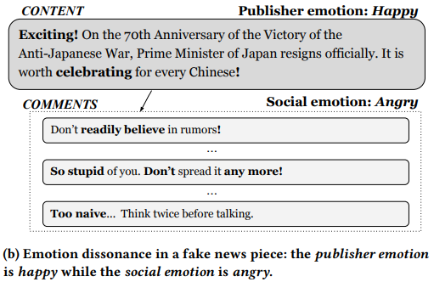
Introduction

Slide 5
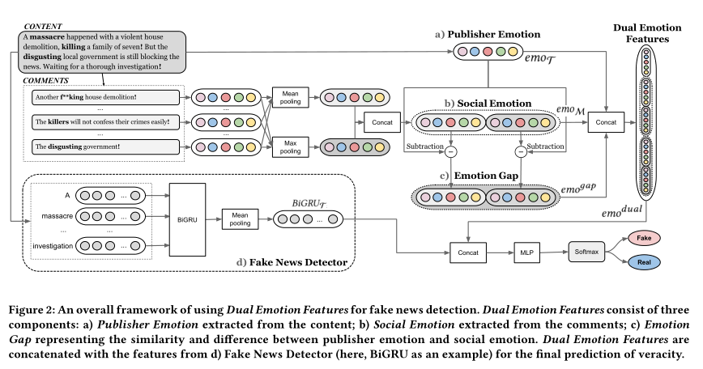
Method

Slide 6
Method
Publisher Emotion
To comprehensively represent the Publisher Emotion, we use a variety of features extracted from news contents.
1.Emotion category
2.emotional lexicon,
3.emotional intensity
4.sentiment score
5.other auxiliary features

Slide 7
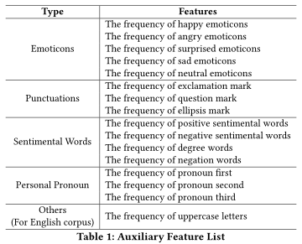
Method
Emotion category
Sentiment score
other auxiliary features

Slide 8
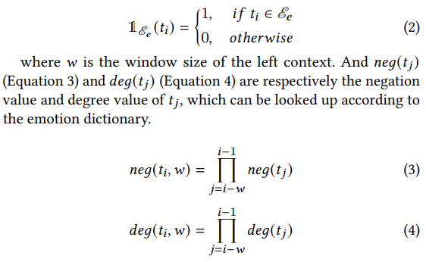
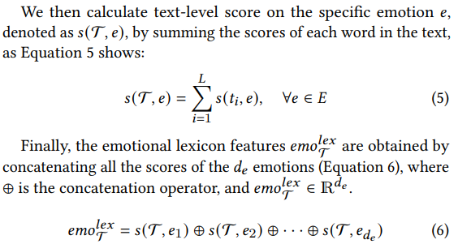
Method
Emotional lexicon
I am not very joyful today

Slide 9
Method
Emotional intensity
the emotion ℎ𝑎𝑝𝑝𝑦, the word “ecstatic” owns a higher intensity than “joyful”

Slide 10
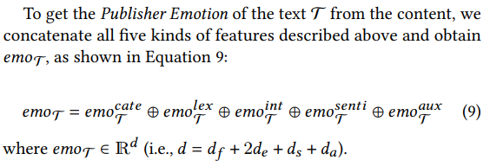
Method

Slide 11
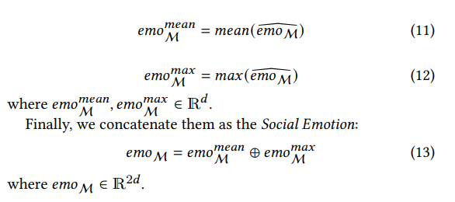
Method
Social Emotion

Slide 12
Method
Emotion gap

Slide 13
Method
Dual Emotion Features

Slide 14
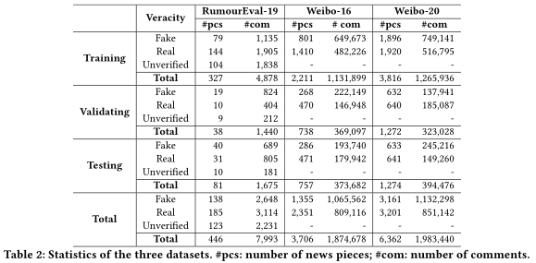
Experiments

Slide 15
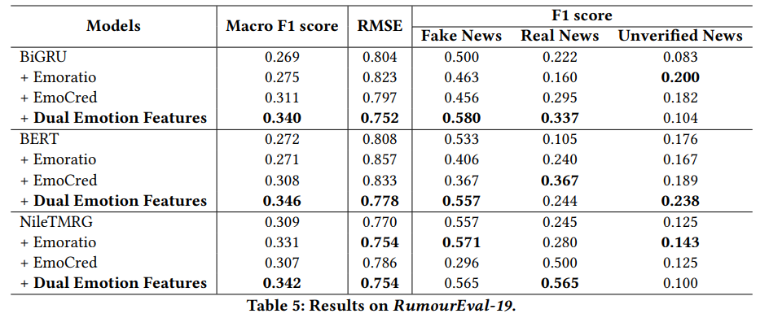
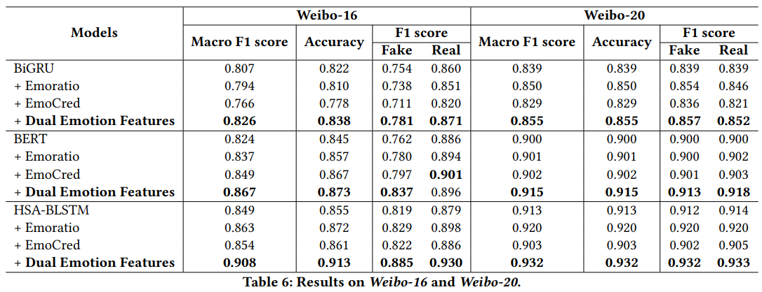
Experiments

Slide 16
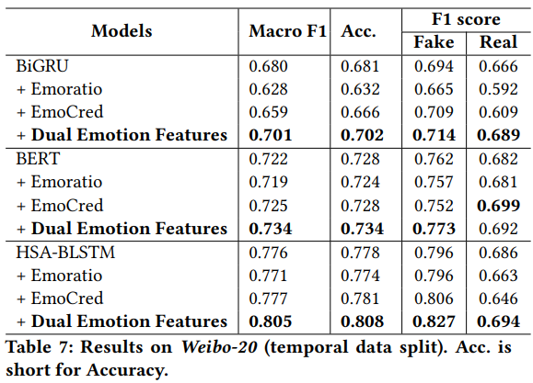
Experiments

Slide 17
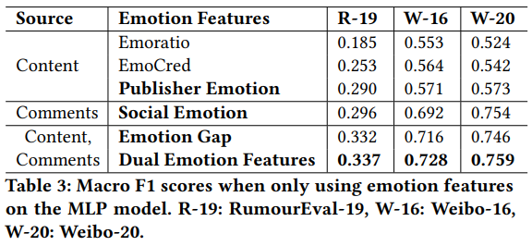
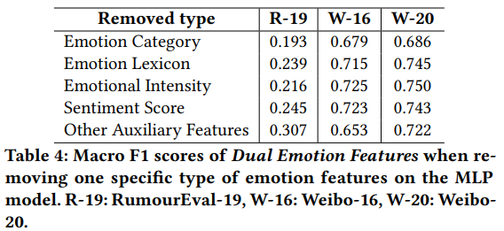
Experiments

Slide 18
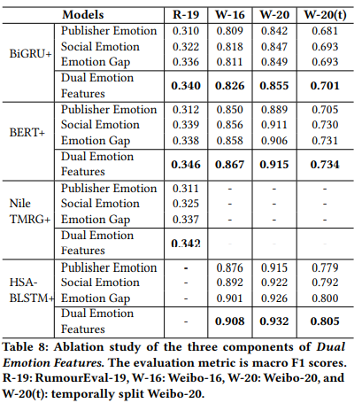
Experiments

Slide 19
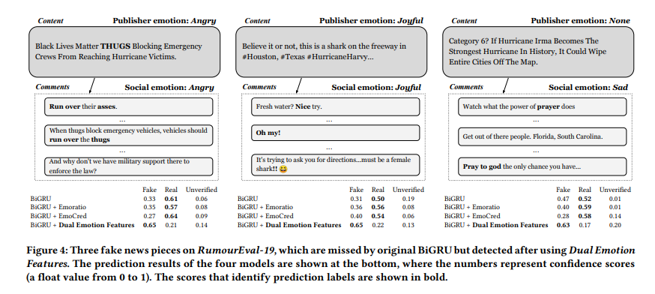
Experiments

Slide 20
Thank you!

